Slide 1

RPG Game
Design slides

Slide 2
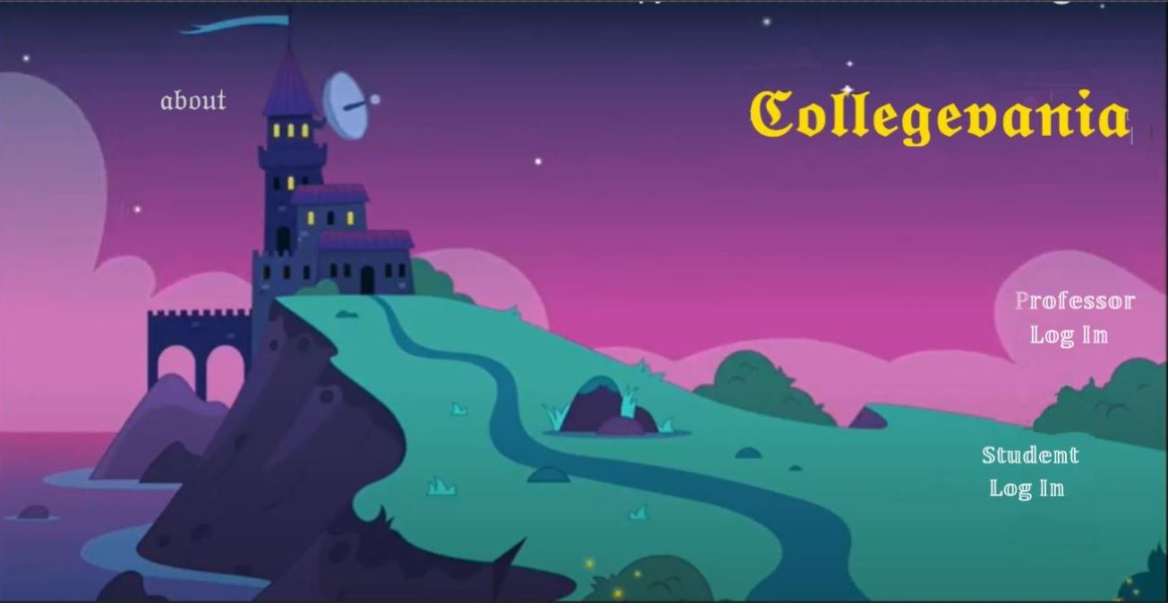

Slide 3
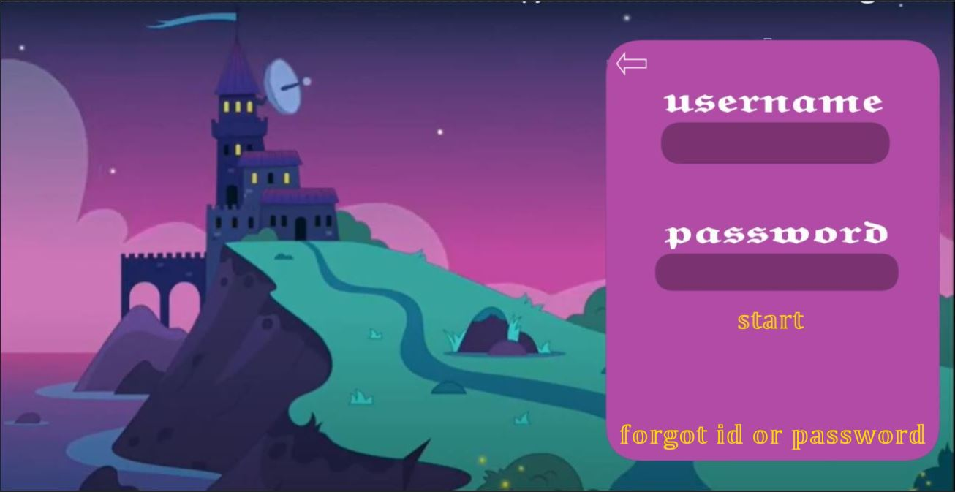

Slide 4
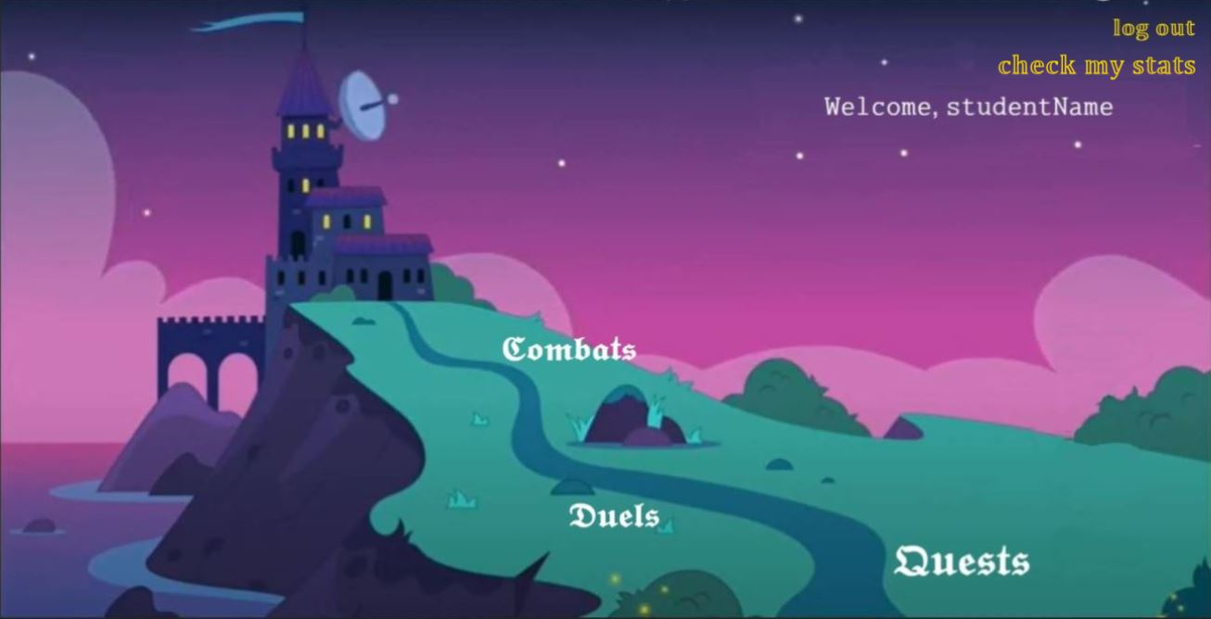
Student: main page

Slide 5
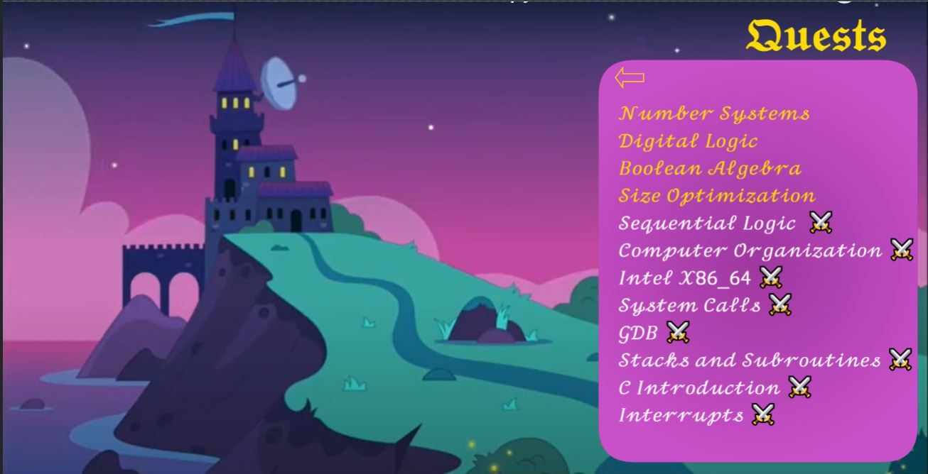
Student: quest (lecture material) page

Slide 6
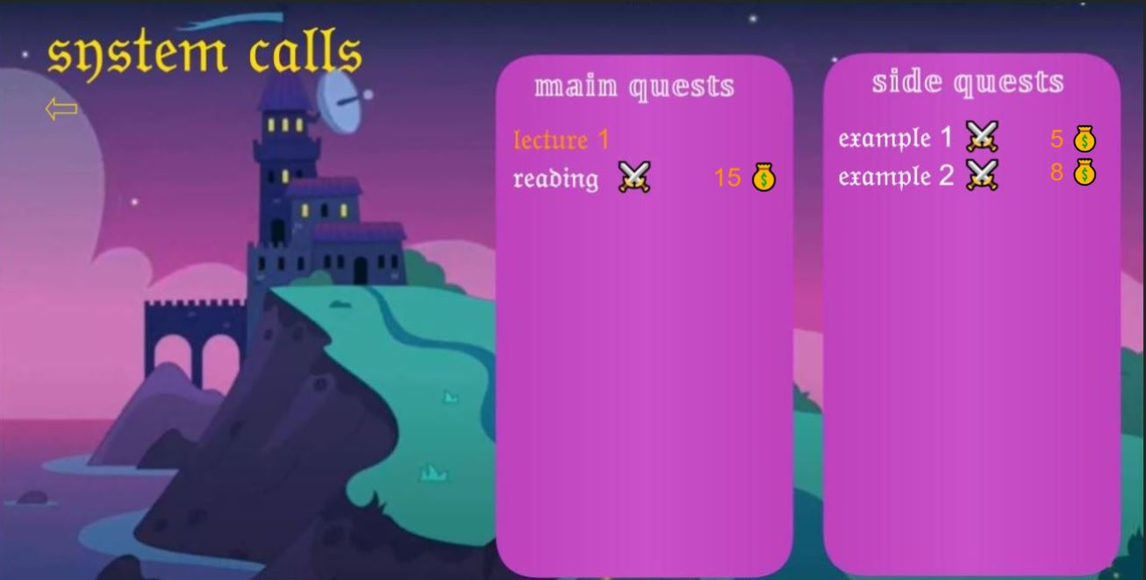
Student: quest topic page ability to choose from side and main quests, orange marked as engaged material white marked as unengaged material numbers of the right side - point awarded for the task arrow returns the user to the previous (list of topics) page

Slide 7
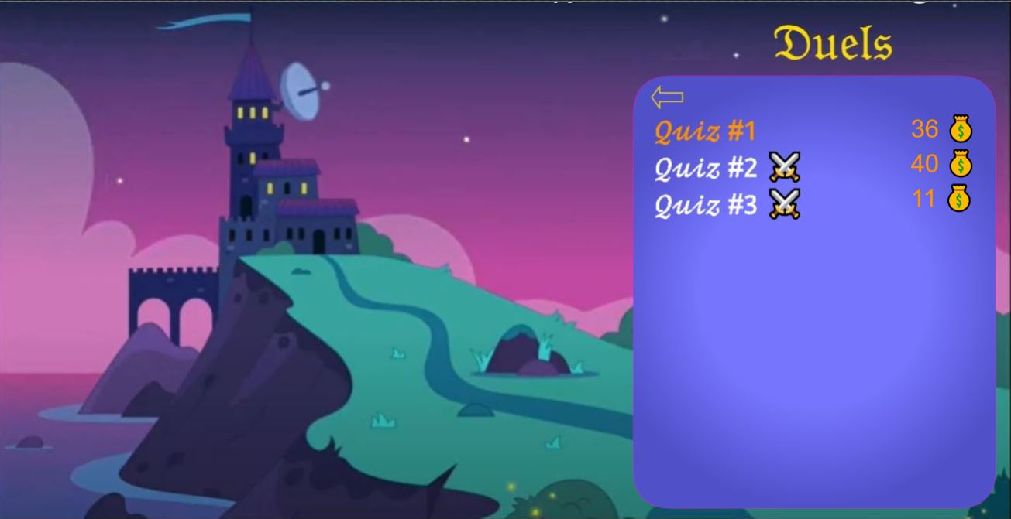
Student: Duels (quiz) page arrow returns to the main page, orange marked engaged material white marked unengaged material number on the right-side coins awarded for the task Same design is for Combat (exams) part

Slide 8
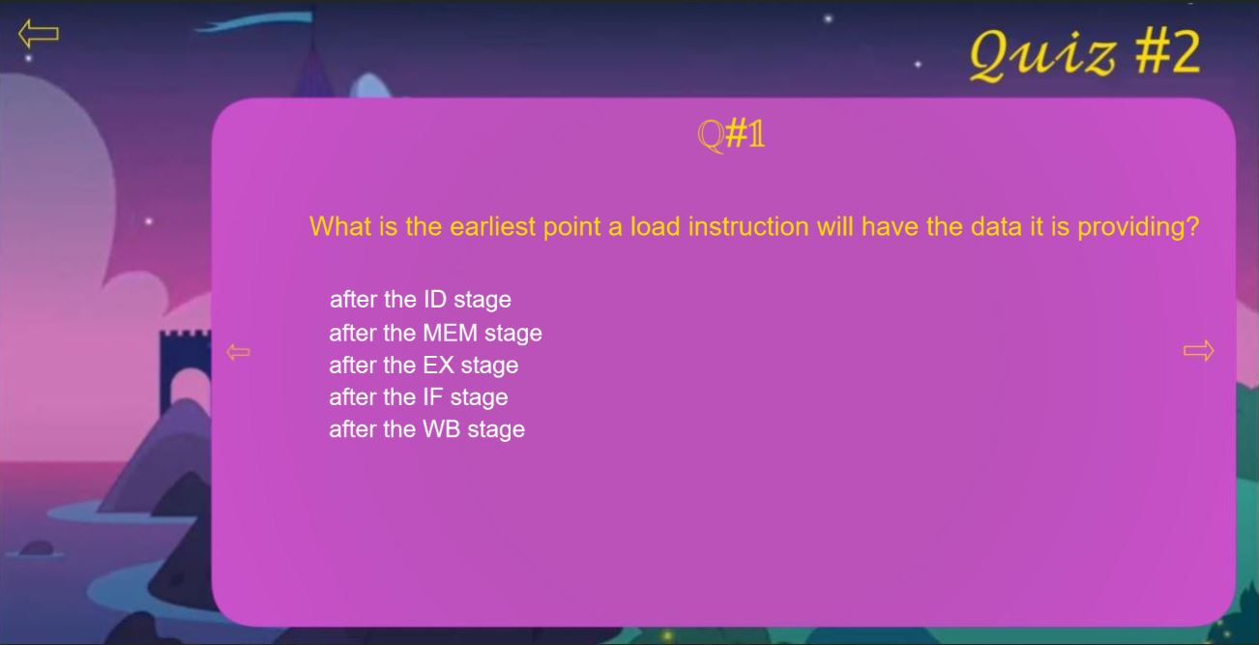
Student: engaging in Duels (quizzes) arrow on the left: leave the quiz(if first question) or move to the previous question arrow to the right: move to the next question Same design is for Exams

Slide 9
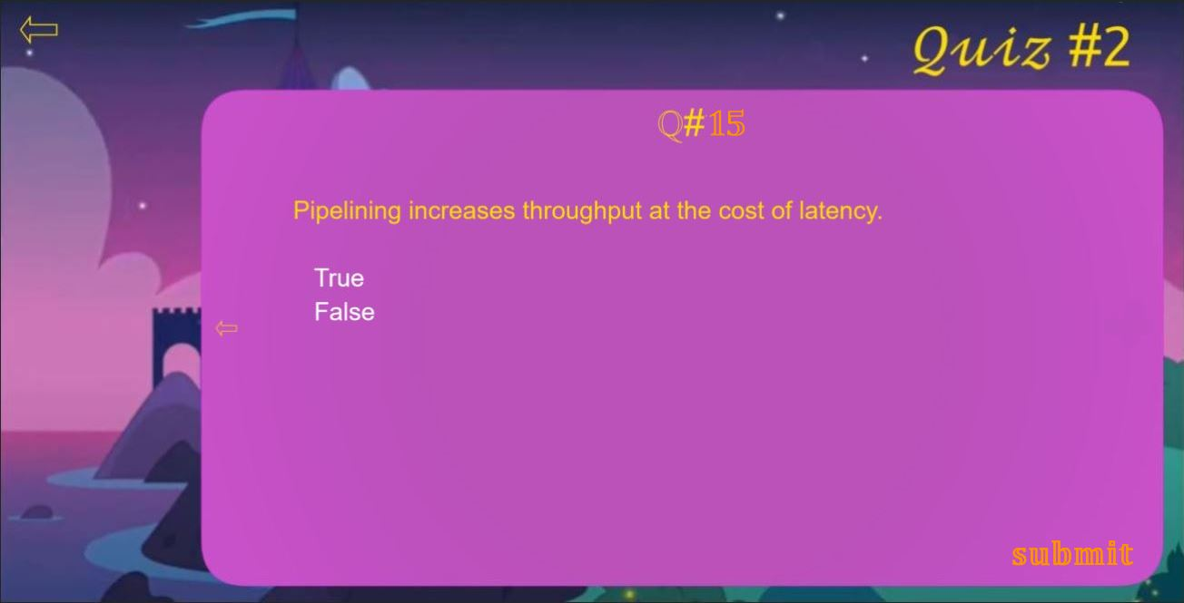
Student: engaging with Quizzes (Duels) arrow to the left: move to the previous question submit button: submit the quiz Same design is for the Exams(combats)

Slide 10
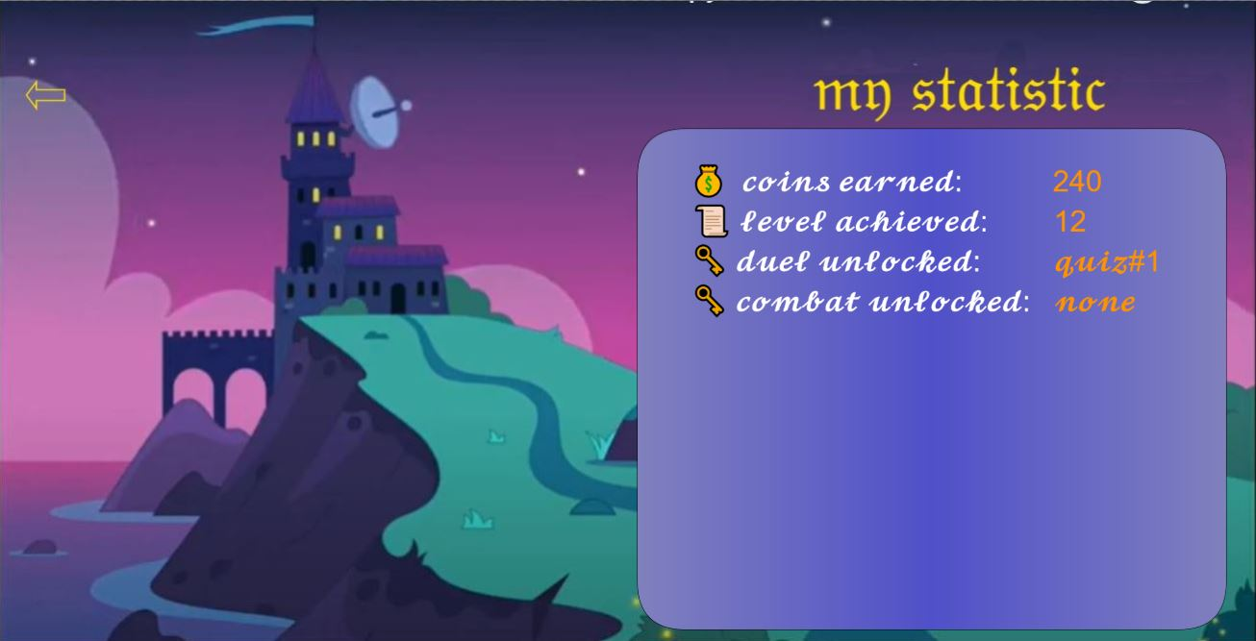
Student: statistics page in discussion

Slide 11
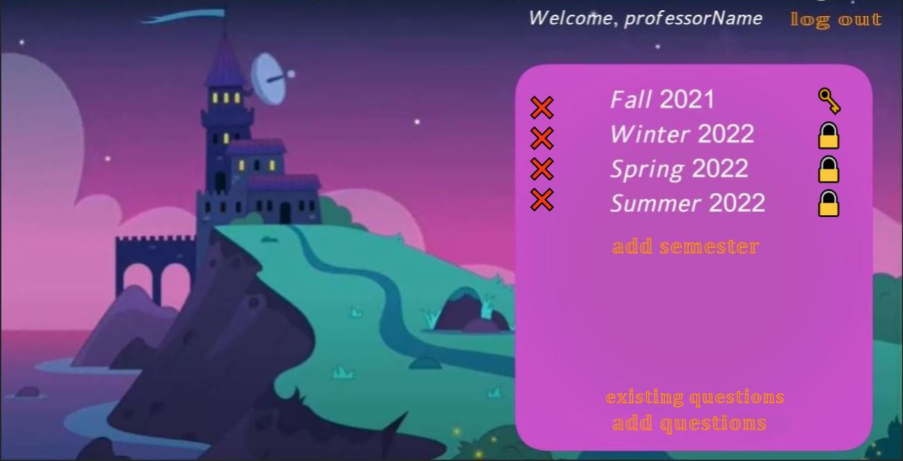
Professor: main view choose a semester add a semester add question - adding unspecified for the class/semester existing questions – check previously saved questions key on the right indicate semester is available to some/all student sections in the semester lock on the right indicate semester is not available for anyone to engage cross on the left side offers to remove the semester completely with all material inside

Slide 12
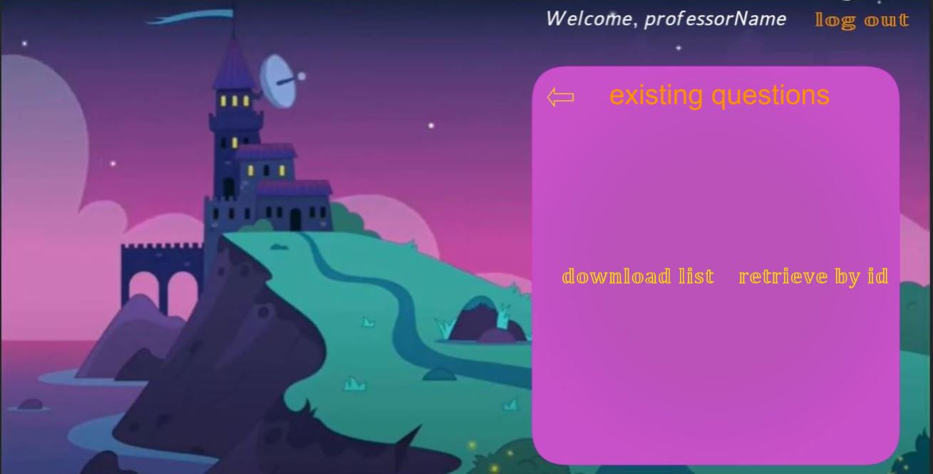
Professor: see existing questions download list – click to download a full list retrieve by id – click to enter id and retrieve the question

Slide 13
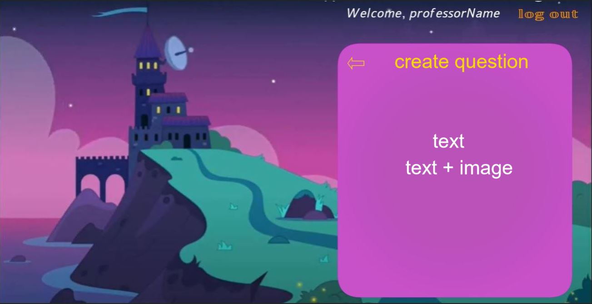
Professor: create a question choose text choose text+image

Slide 14
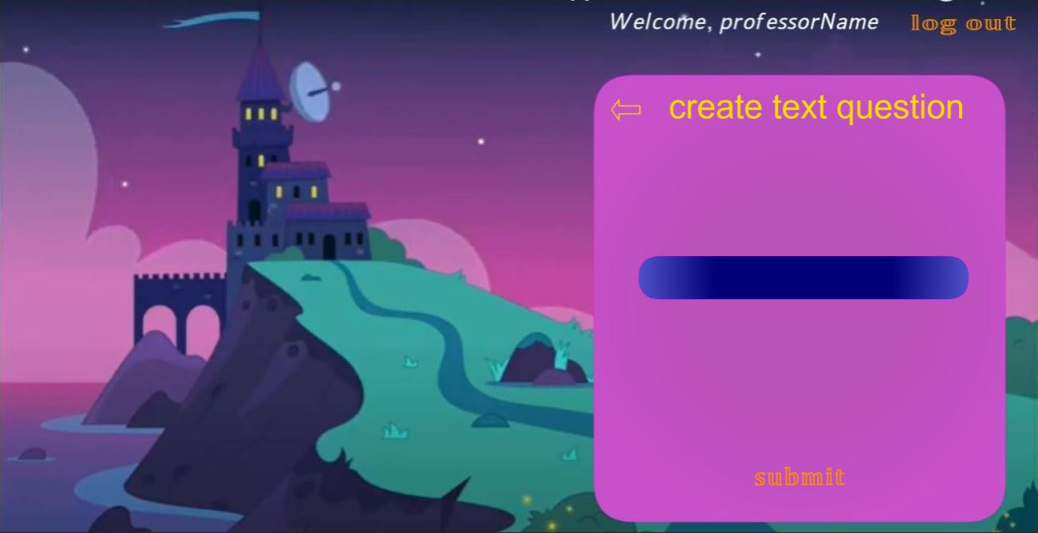
Professor: enter text question enter text in the blue field press submit to save

Slide 15
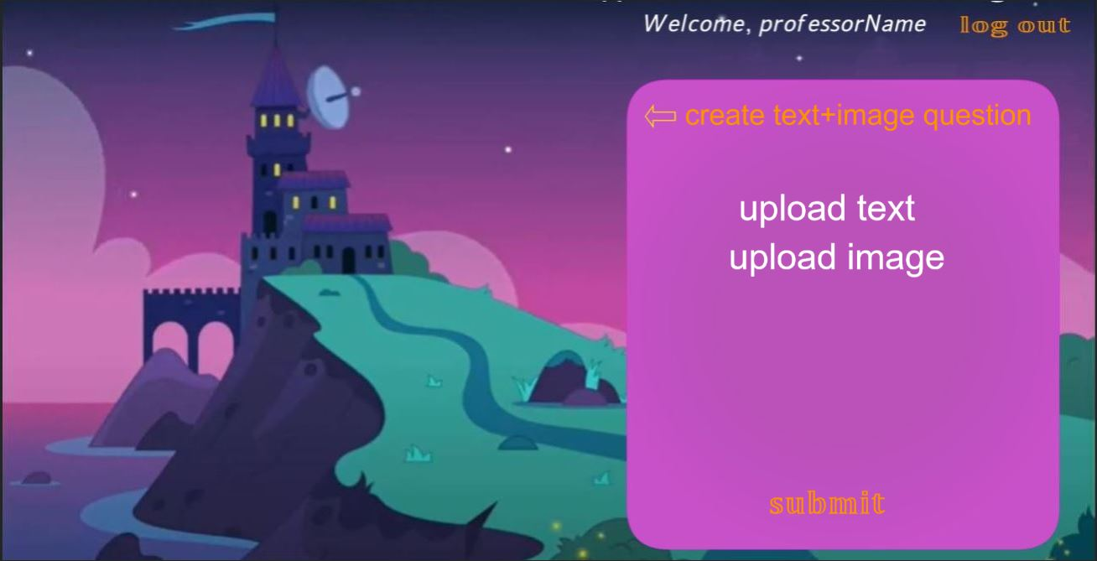
Professor: enter text question enter text by clicking upload text upload image by clicking upload image press submit to save

Slide 16

Professor: view of classes for a semester click on class to view add class to add class key on the right indicate class is available to students, click to change to the lock lock on the right indicate classis not available for anyone to engage, click to change to the key cross on the left side offers to remove the section completely with all material inside

Slide 17

Professor: view of material for the class click to view quests, duels, combats or class statistics

Slide 18
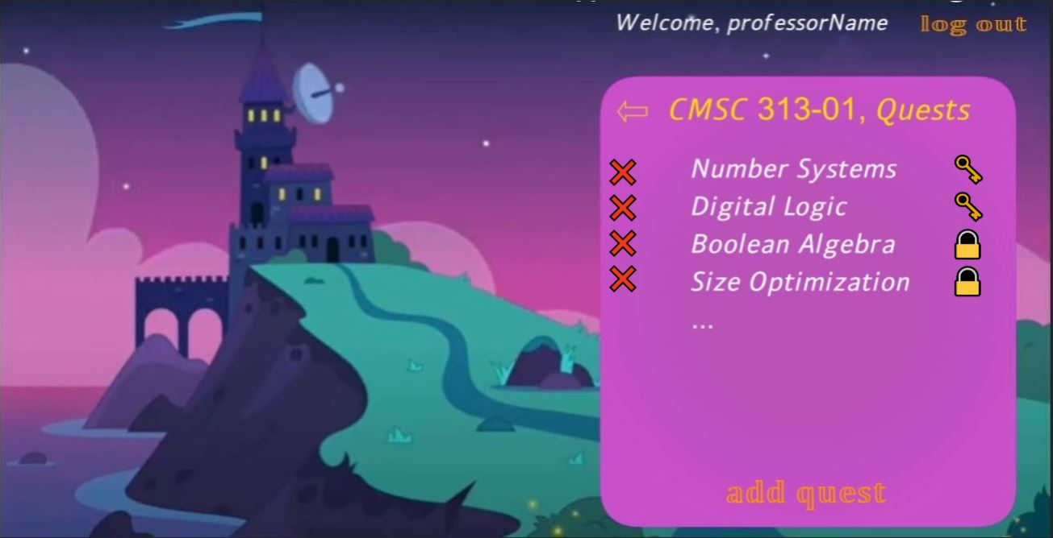
Professor: view of the available lecture material click to view click add quest to add new topic key on the right indicate material is available to students, click to change lock on the right indicate material is not available for anyone to engage, click to change cross on the left side offers to remove the section completely with all material inside

Slide 19
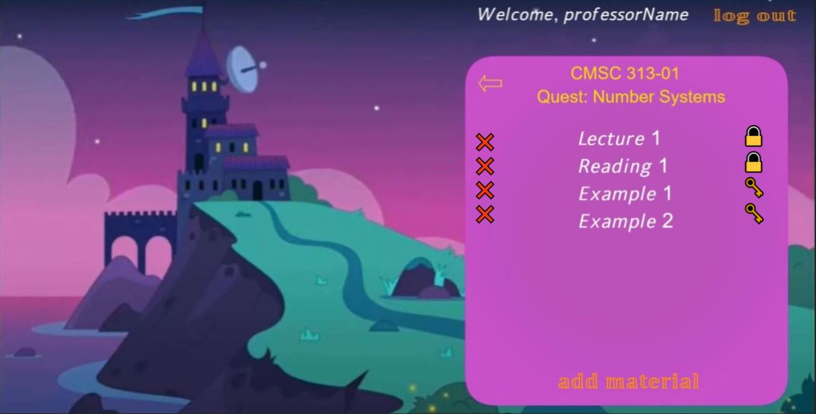
Professor: view topic and available lecture material click to view click add material to add new material key on the right indicate material is available to students, click to change lock on the right indicate material is not available for anyone to engage, click to change cross on the left side offers to remove the section completely with all material inside

Slide 20

Professor: Add material for a lecture material click to add material

Slide 21

Professor: add video material to the lecture material click to choose link/file enter title for the material enter points when engaged choose main or side quest click submit to save

Slide 22

Professor: view available quizzes click to view click add duel to add new quiz key on the right indicate material is available to students, click to change lock on the right indicate material is not available for anyone to engage, click to change cross on the left side offers to remove the section completely with all material inside

Slide 23
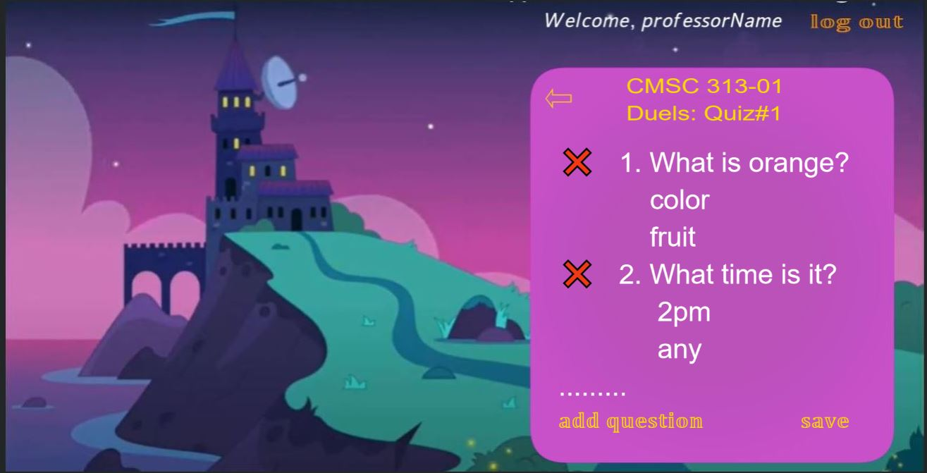
Professor: edit available questions for a quiz click cross on the left to remove the question form the quiz click add question to add a new question to the quiz click save to save the state of the quiz

Slide 24
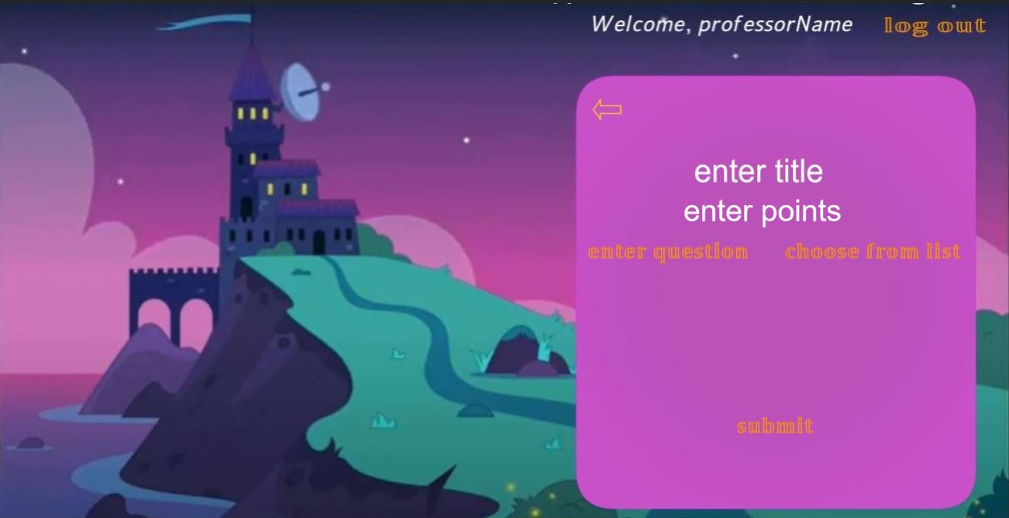
Professor: enter quiz title enter points when engaged choose enter new question/ choose from existing list click submit when all questions added

Slide 25
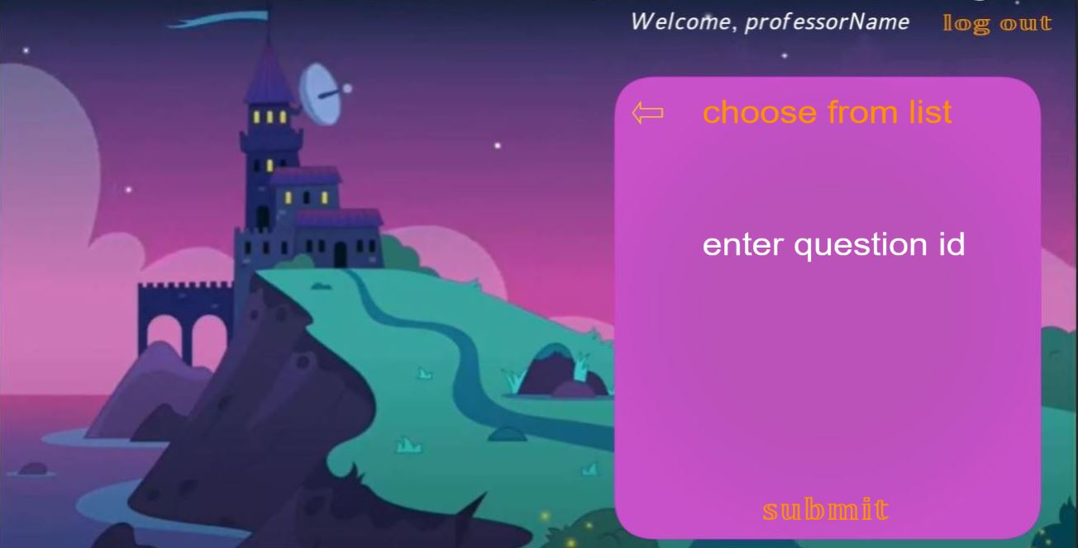
Professor: choose question from existing list enter question id after clicking enter question id click submit to save the question to the quiz

